Slide 1
ENVIRO CASE STUDY
SECOND ROUND

Slide 2
Name of the participants:
1) Name: Domendra Sahu(Project Lead)
College: GEC BILASPUR
2) Name: Aditya Sahu
College: GEC BILASPUR
3) Name: Prachi Sahu
College: GEC BILASPUR

Slide 3
Assumption
A Mining Project is being planned which will be using water from a nearby river for its operations. There are also other stakeholders who use the river water for other use. There is an apprehension that due to commissioning of the project, the effects will be felt downstream.

Slide 4
Importance of Water in mining industry
Water is basically used in mining for mineral processing, dust suppression, slurry transport and employees’ needs. In most of the mining operations, water is seeking from groundwater, streams, rivers and lakes, or through commercial water service suppliers. Over the last several decades, the industry has made much progress in developing close-circuit approaches that maximize water conservation. At the same time, operations are often located in areas where there is not only significant competing municipal, agricultural and industrial demands but also very different perspectives on the role of water culturally and spiritually.

Slide 5
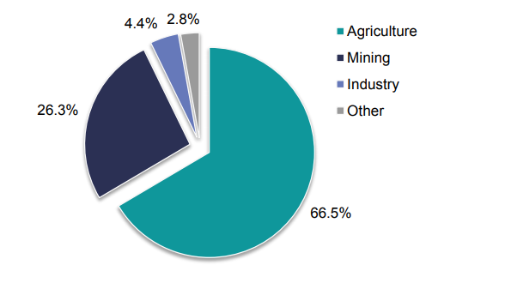
Usage of water in different sectors

Slide 6

Problem Statements and their solutions

Slide 7

1) How should the mine address the concern in the design stage? What specific interventions, framework that it should adopt to ensure that the project starts the way it is planned?

Slide 8
Whosoever is concerned, needs to take the locals in our confidence and should sought their support.
As in the case of Coal Mining conflict in Hazaribagh with NTPC in Jharkhand.
Hazaribagh witnessed an unfortunate event where the locals while protesting against the land acquisition by the officials were shot by the police. Their appeal was not to handover their fertile farmlands as the compensation provided weren’t sufficient. Almost half of the recorded lands were secured by the officials.
The folks carried out numerous protests, demonstration, etc. including the Koyla Satyagraha. Still the rest are continuing with the ongoing resistance.
These series of events were the outcome of the previous illegal land acquisitions and injustices among the folk. This No-confidence by the locals on the authorities gave emergence to the events.
Every action which are going to take place must have legal permissions.
Last but not the least, there must be a body to check the efficiency of water used by the stakeholders. There should be a body who will keep a check on them regarding the amount of water they sought from and the amount of which is really in need.

Slide 9

2) What should be the required policies and processes that the company should adopt to ensure that operations are conducted in a manner conforming to the requirements of the regulations?

Slide 10
In this we need to get a proper permission from government regarding taking land on lease which should ensure that it will harm environment to the minimum and work on the given set of guidelines.
Must maintain a database which includes all legal permission documents, proper data of extraction and production, in stock equipment data (No. Of drill bits, amt. Of explosives etc.).
We need to take all kind of safety measures and precautions in accordance with the norms of DGMS in order to avoid fatal accidents.
We should set up water treatment plants near mining areas. During running of mines there are some toxic waste which has to be treated. If they are not treated well then it can harm soil, water/water bed and air quality which can further affect the flora and fauna of that area.

Slide 11

3) How should the project proponent address the concerns of the external stakeholders?

Slide 12
Project proponent should make a body to check against them by the authority and Environmentalists and should try to develop sustainable and eco-friendly way for their resource management and making substantial profit out of it.
The role companies can play in providing water to local communities and stakeholders, whether by working in partnership with non-governmental organization (NGO) providers by establishing water treatment plant.
Certain new techniques of water accumulation like rain water harvesting, roof top harvesting can be introduced and promoted by the companies covering the interests of local communities.

Slide 13

4) What long term interventions it can plan to mitigate the concerns of shortage of water of the community? Please elaborate.

Slide 14
First of all, there must be a check on the efficiency of water usage by mines to control the wastage of water.
Company should establish water treatment plant near the mines and should provide treated water to the community.
As we witnessed, e-Malahleni Water Reclamation Plant in South Africa (operated by Anglo American in partnership with BHP Billiton) treats the contaminated water from its own and other mining operations and delivers treated water directly into the local municipality’s drinking water system. This arrangement is a good example of a successful public-private partnership.

Slide 15
In glimpse of the past:
Farakka, West Bengal – In 2018, a coal fired power station shut down five of six turbines due to lack of water.
Jaduguda, Jharkhand – While the uranium mine belonging to a government owned enterprise was shut down in 2014 following issues around lease renewal, the contamination of ground water led to fierce community protests.
Bharuch, Gujarat – In 2016, some plants of a major petrochemical facility were shut down due to constraints of water availability.
Dasna, Uttar Pradesh – In 2016, a plant of a major F&B company was shut down through judicial intervention on untreated wastewater.

Slide 16

THANK YOU

